Slide 1
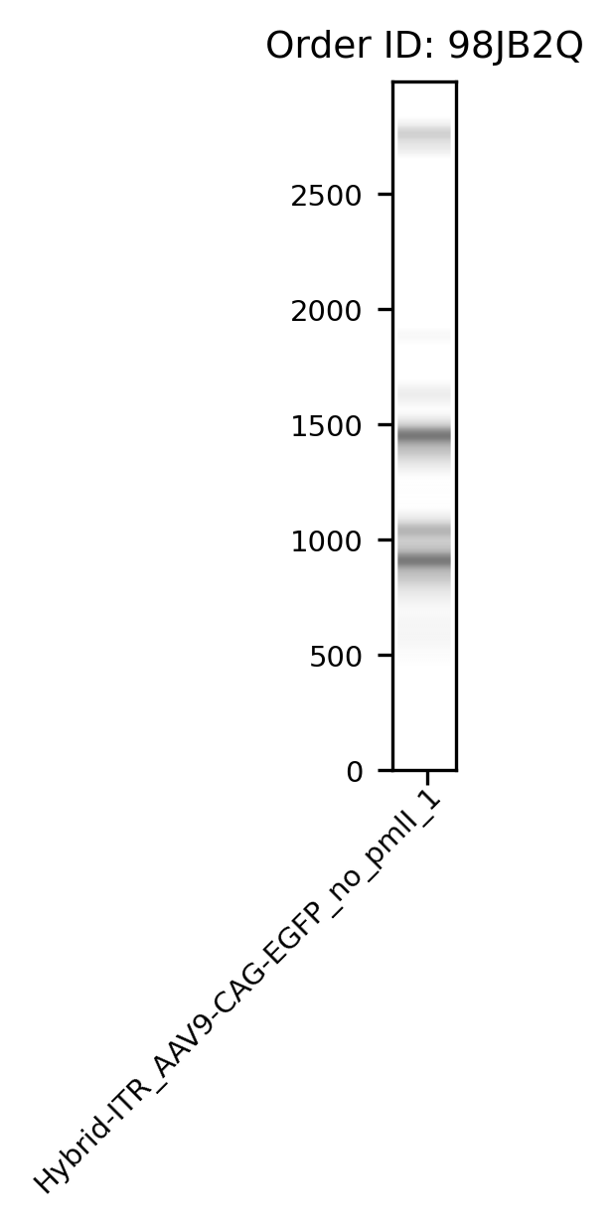
*
*
*

Slide 2
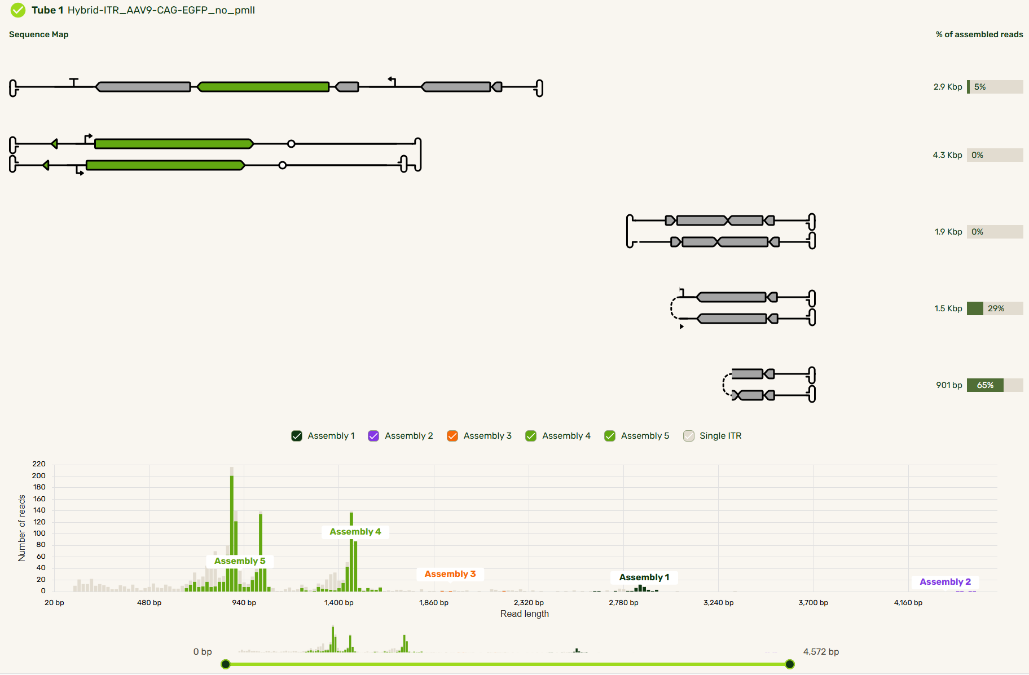
*Expected size~2.9Kb
Bad news: 3’dBC-ITR got repaired from 104bp back to WT 145bp
145bp!
137bp
Compared to WT-ITR, no PmlI:
1.2.9Kb full EGFP cassette increased from 1% to 5%, like addgene WT, great
2. 6.7/6.9Kb species disappeared (3 Amps)
3. New 4.3Kb species with <0.5% (2 Amps)
4.1.5Kb species, similar %
5. 901bp species decreased a bit

Slide 3
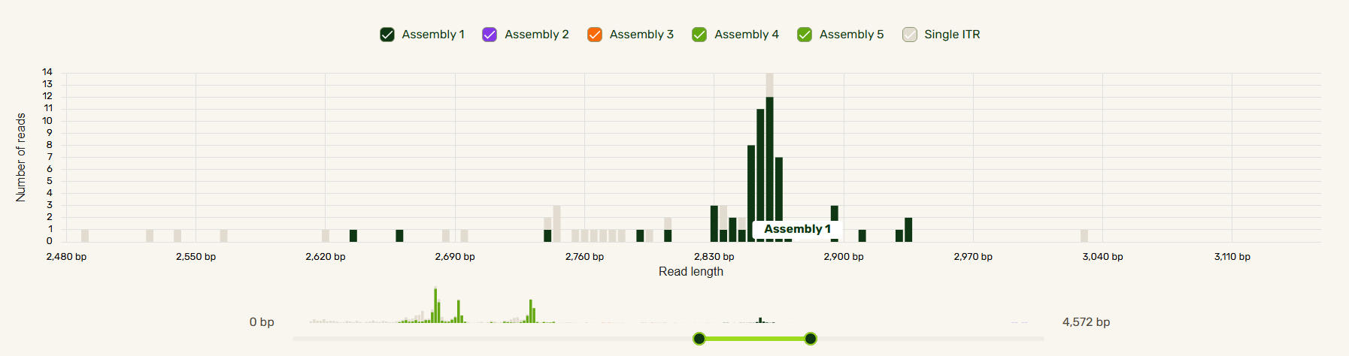
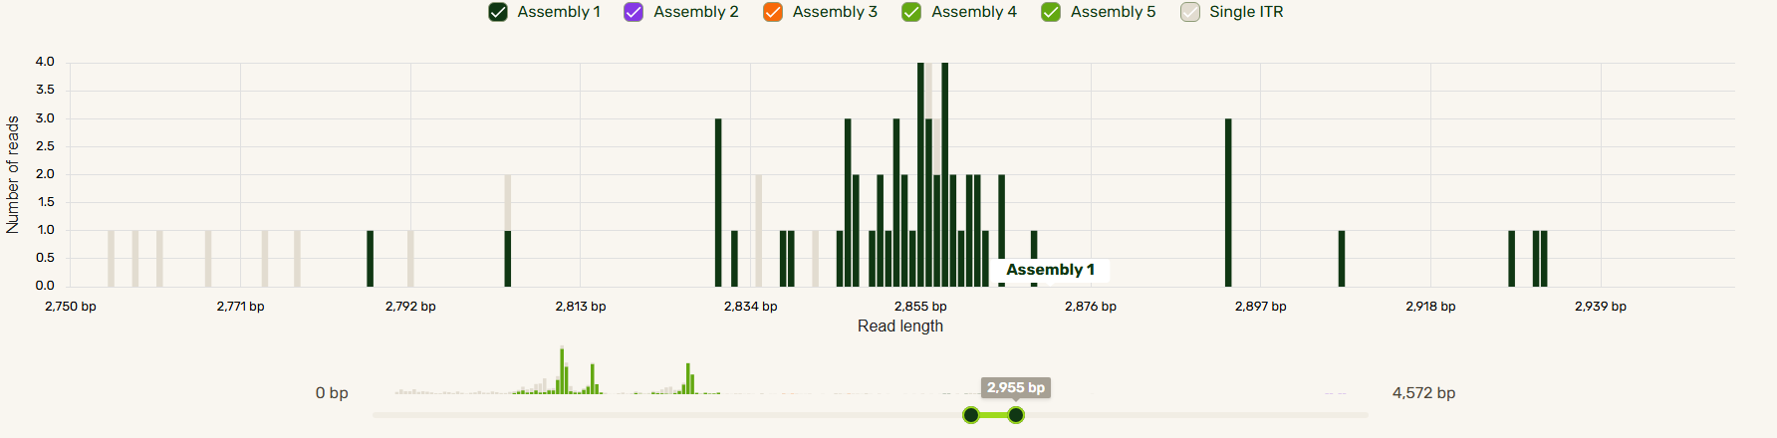
Hybrid: 5’WT-ITR+3’dBC-ITR(104bp)=2834bp
If 3’dBC-ITR is repaired to 145bp=2875bp
The assembly 1 seq result says=2870bp with 5’ITR=137bp, 3’ITR=WT, 145bp

